Slide 1

Project: TA Report Web App
IE04 Weekly Progress Report, Phase Demo 2
2023/12/06
Team: Pikachu

Slide 2
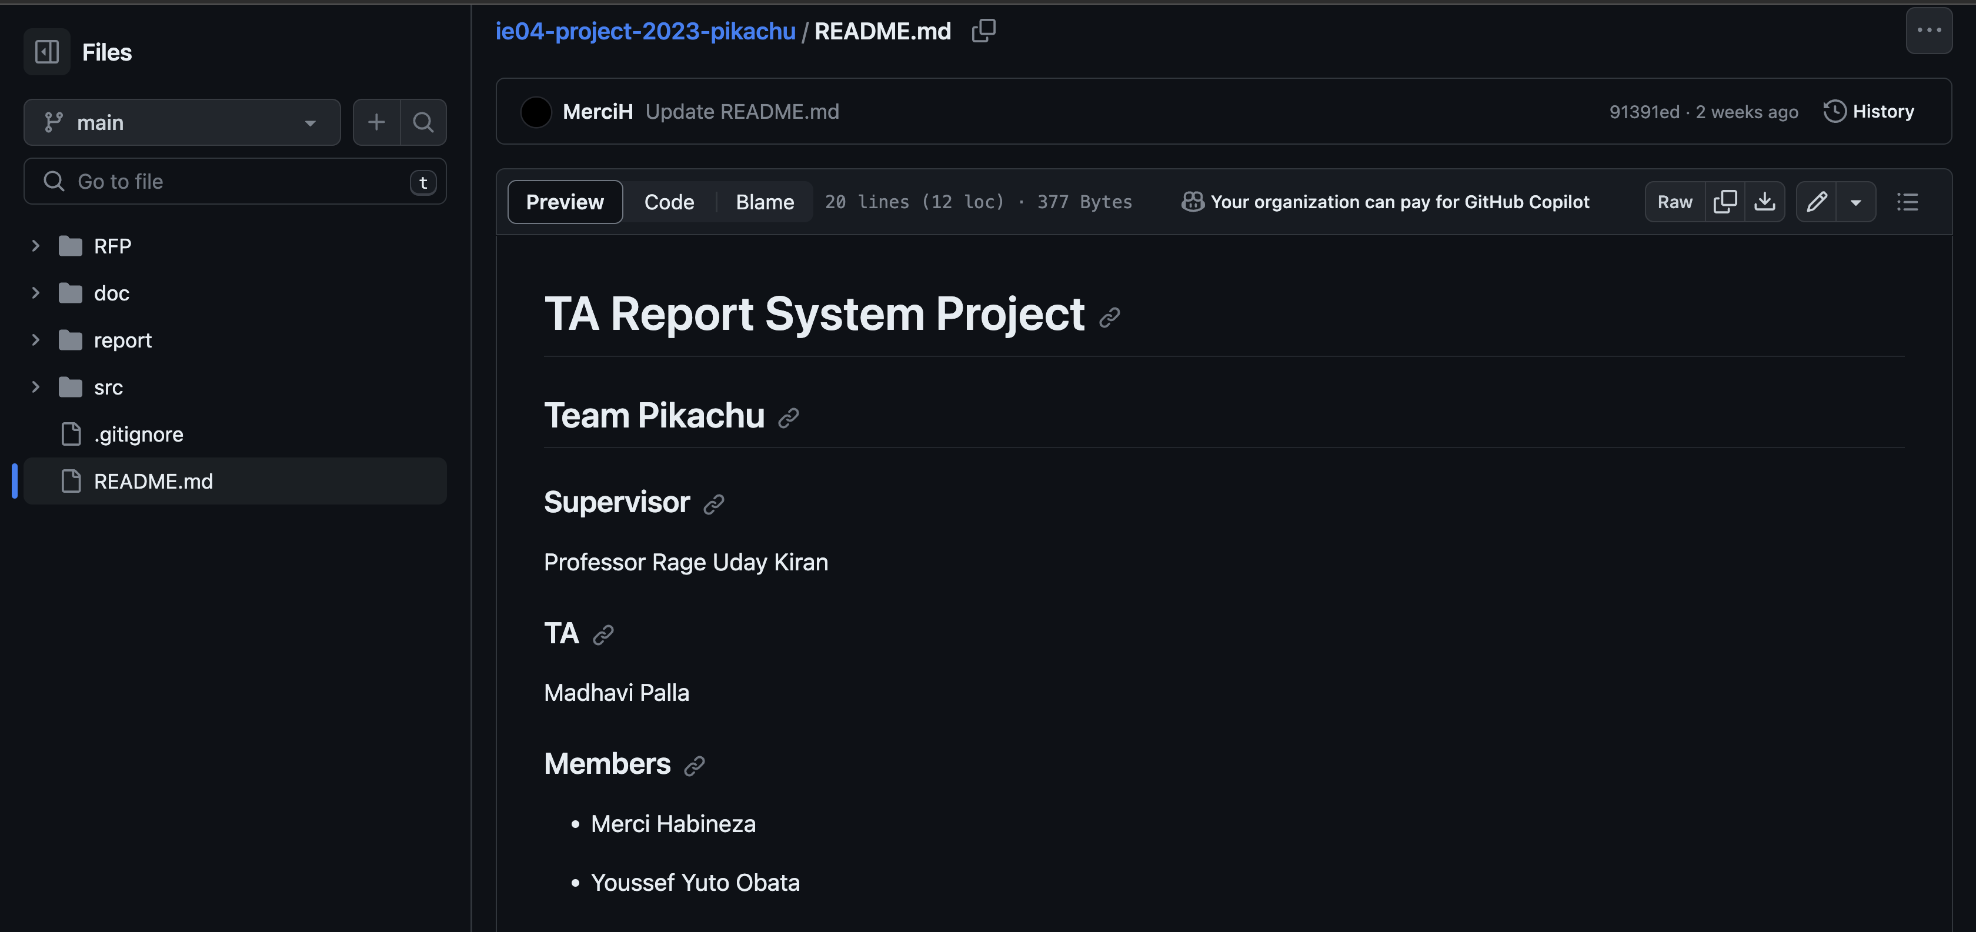
Introduction

Slide 3
Activities of Previous 2 Weeks
Task | Member | Work Hours
Sequence diagram | Merci | 0:30
(UI front-end) login screen | Youssef | 5:30
(UI front-end) TA course screen | Youssef | 9:30
(UI front-end) TA report screen | Youssef | 8:30
(back-end) Database | Merci | 5:30
(back-end) API | Merci | 8:30
 | Total time: | 37h:00

Slide 4
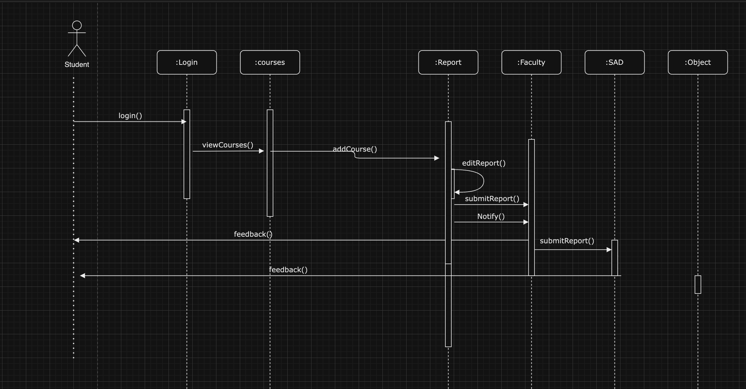
Sequence Diagram

Slide 5
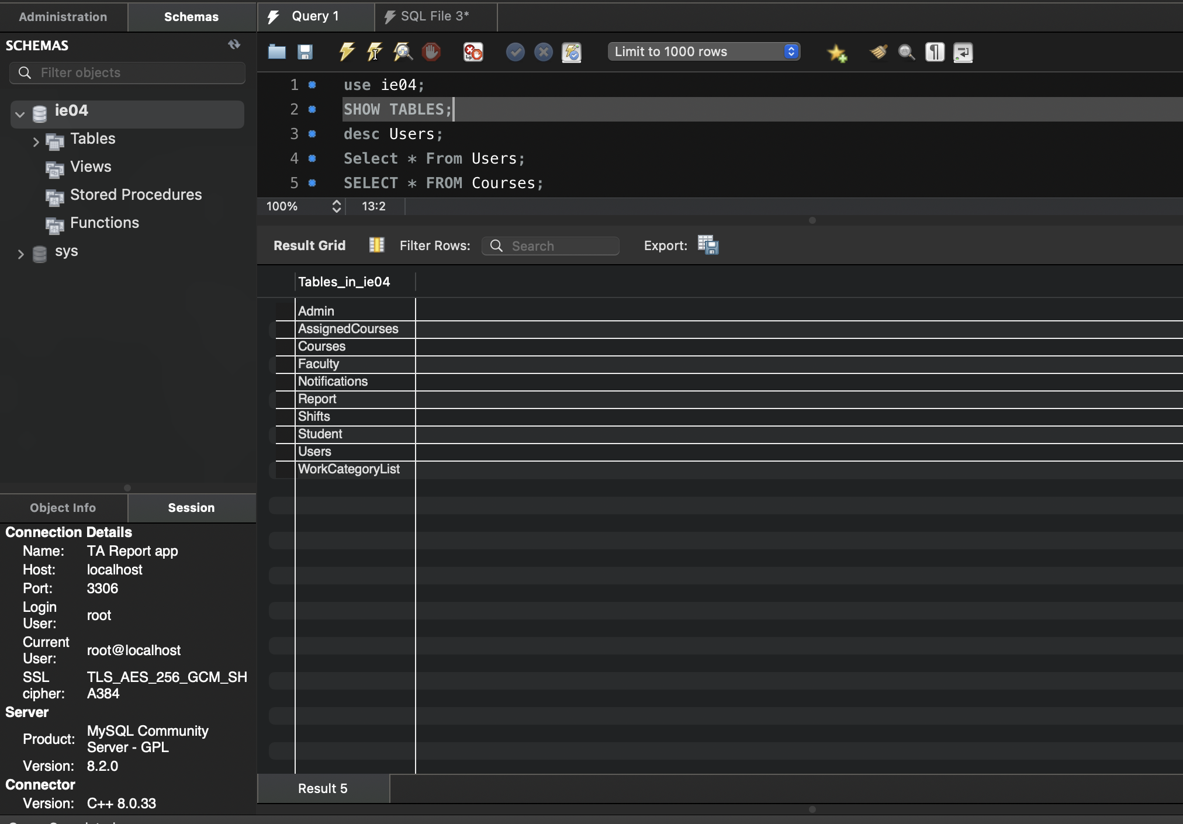
Database

Slide 6
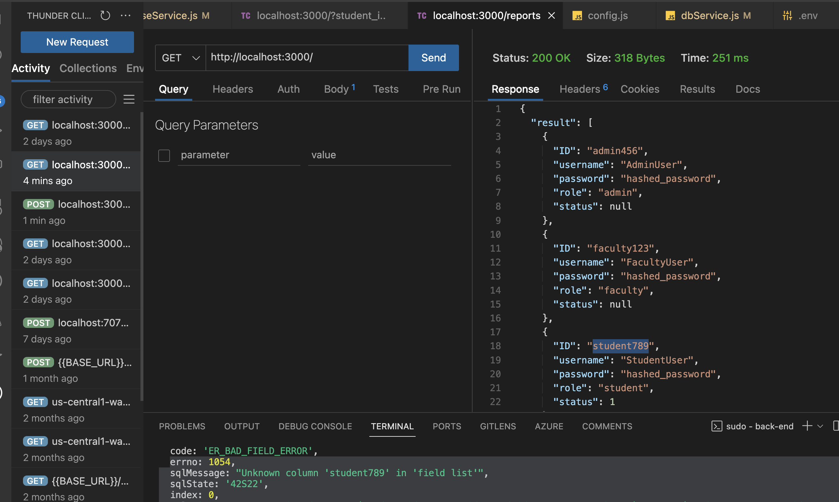
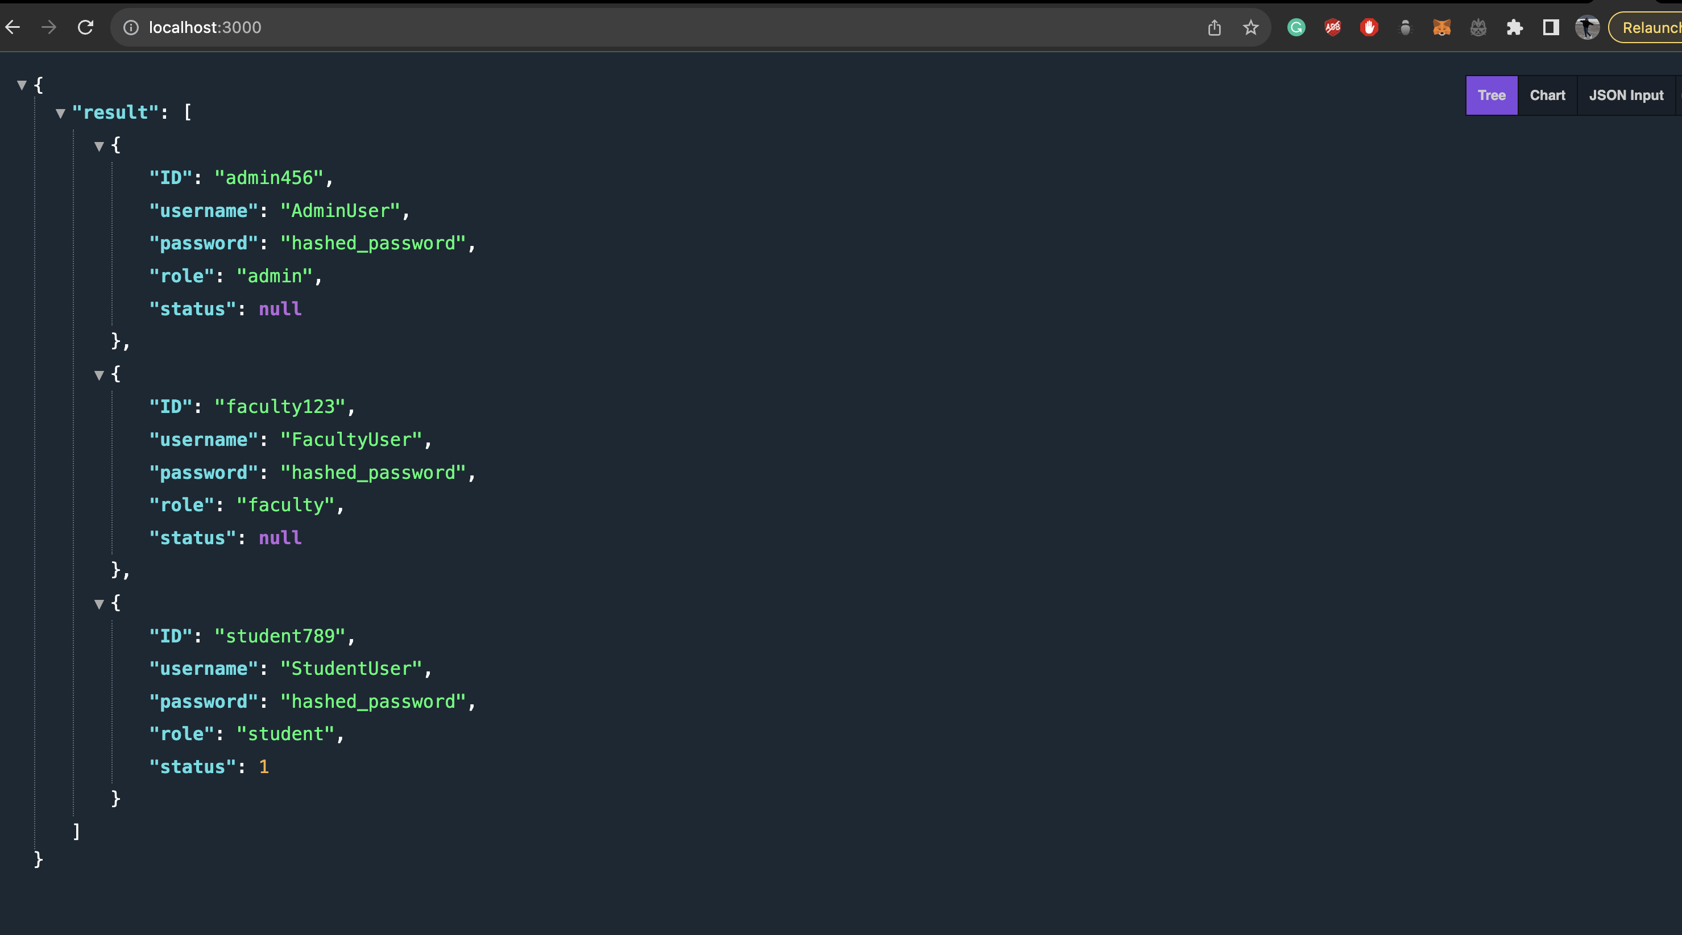
API

Slide 7
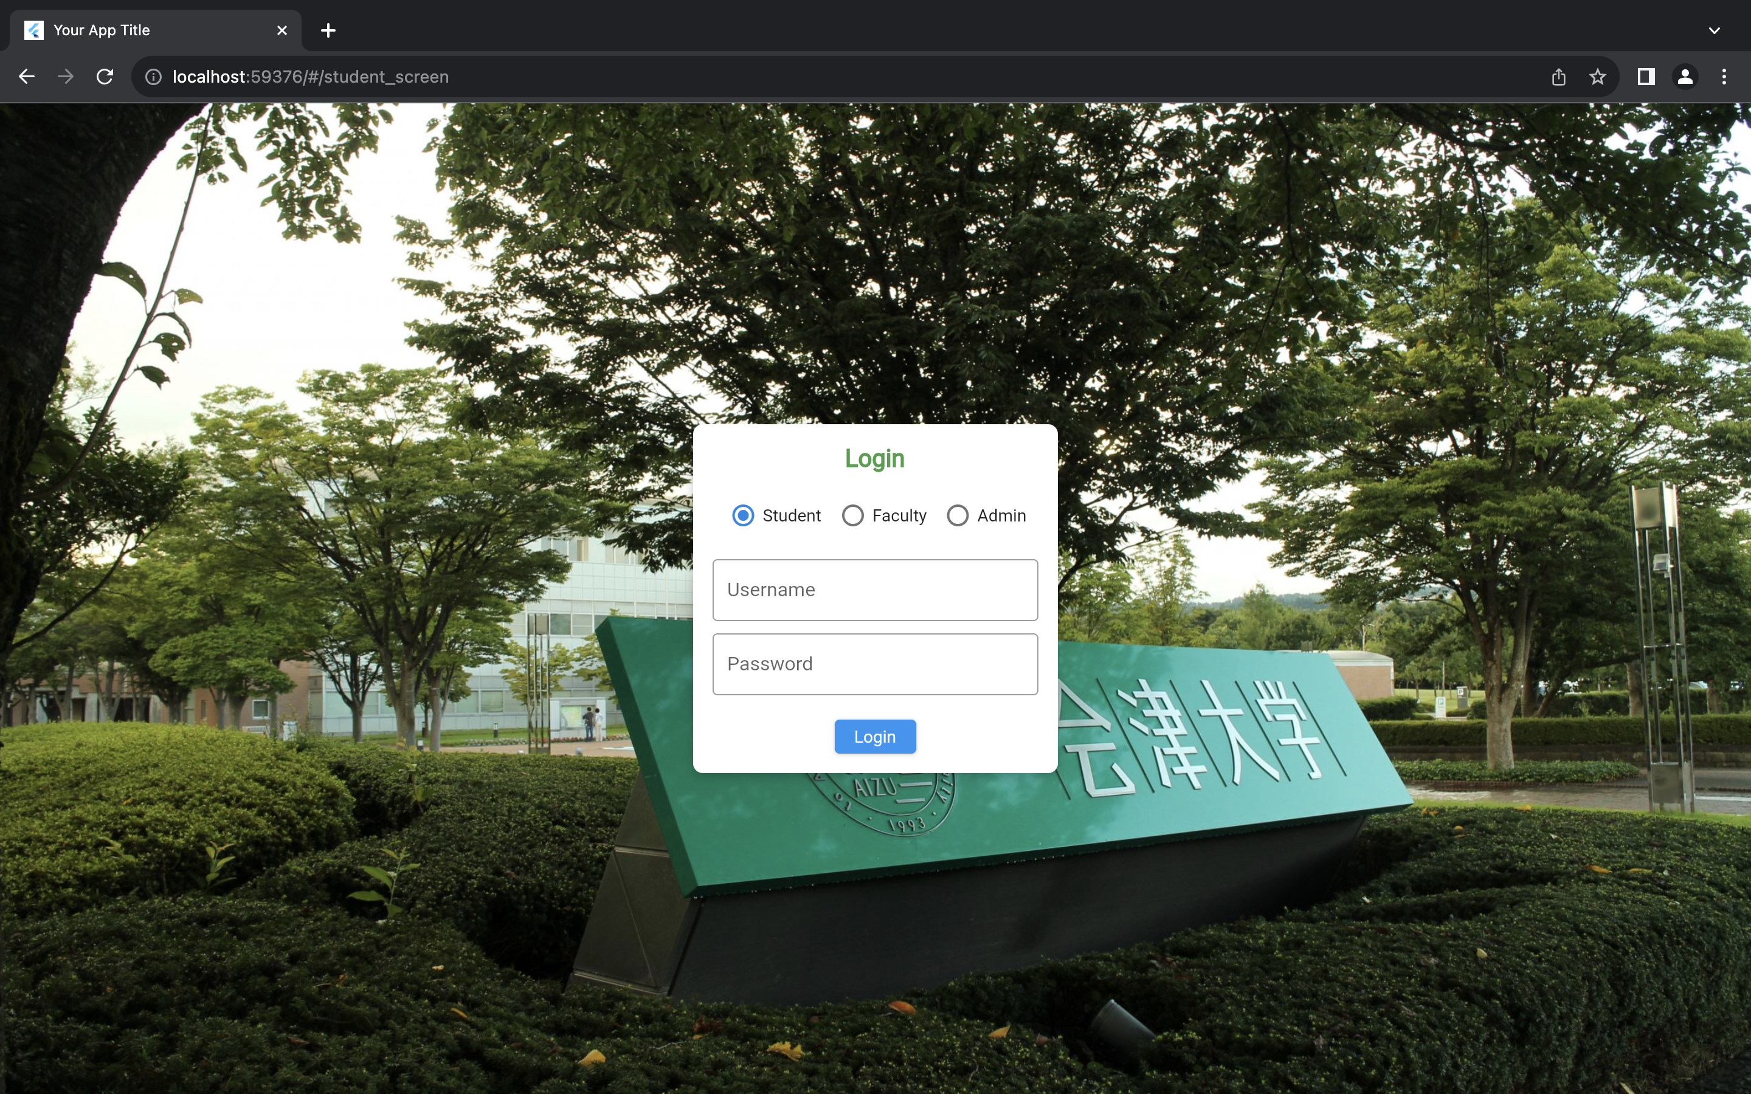
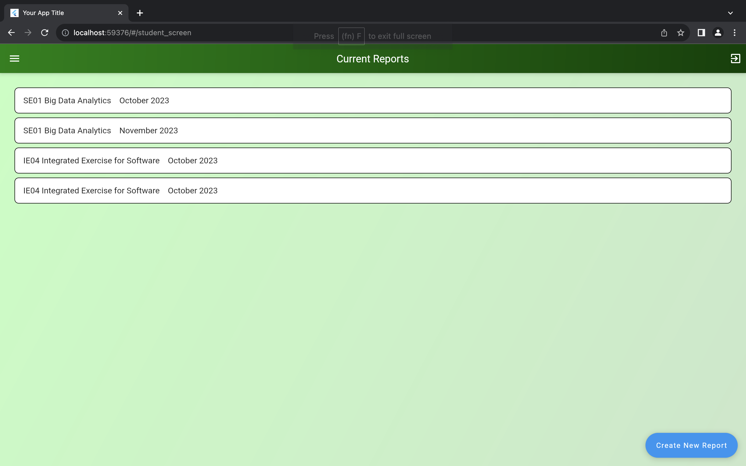
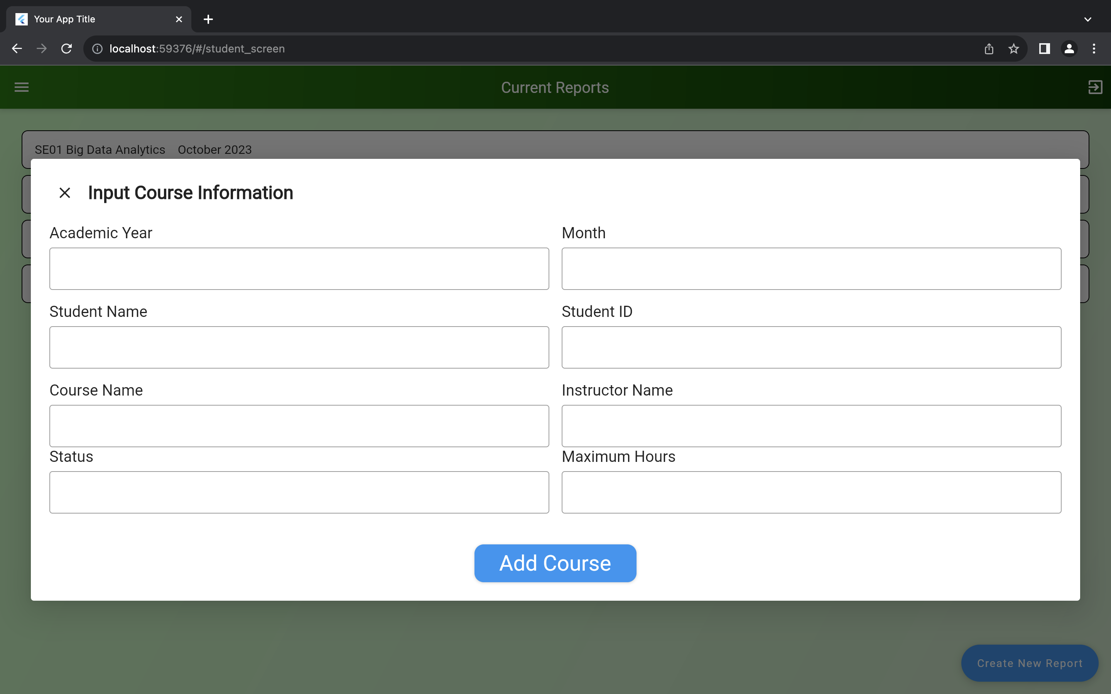
Front-End

Slide 8
Plan for Next Week
Task | Member | Work Hours
Finish TA Pages (by this week) | Youssef | 10:00
Finish API (by this week) | Merci | 5:30
(Front-end& back-end) API connect (next Wednesday) | Youssef | 2:30
(back-end) Authentication API (start from Thursday) | Merci | 8:00
(Front-end) Authentication (start from Thursday) | Youssef | 5:30
 | Total time: | 16h:00

Slide 9
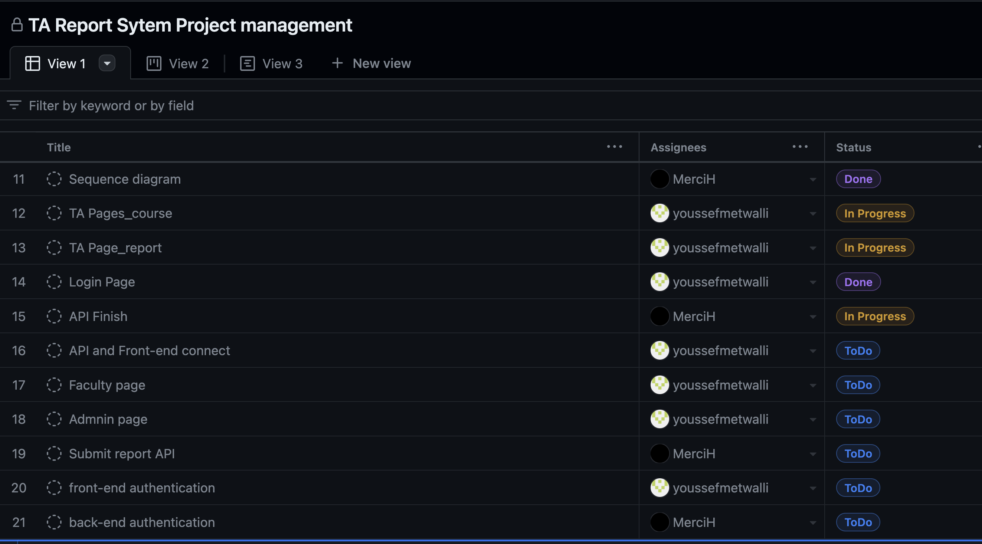
Phase Task Board

Slide 10
Issues & Risks (*if any)
Problem: API errors, still implementing time restrictions
Cause: Bugs
Possible Solution: correct
Deadline

Slide 11

Thank you

